Slide 1
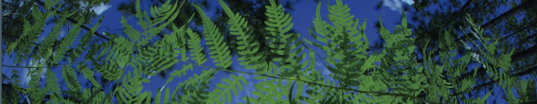

Occurrence Record Cleaning
University of Florida

Slide 2
What data are we using?

Slide 3
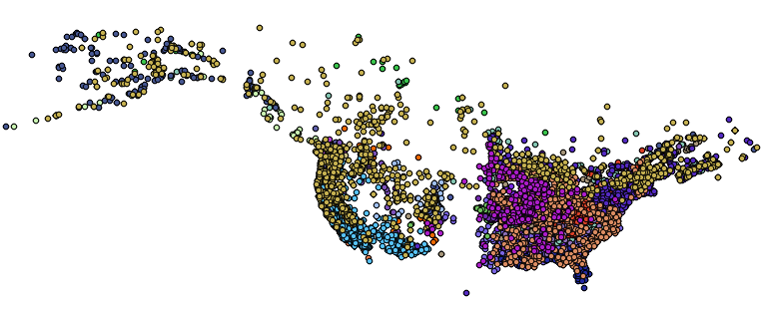
What data are we using?
1. Georeferenced occurrence records

Slide 4
Georeferenced
01_Download_Occurrence_Data.R
02_Occurrence_Data_Cleaning.R
Request points

Slide 5
Identify points where locality strings are present, AND lat/long are absent.
Georeferenced
01_Download_Occurrence_Data.R
02_Occurrence_Data_Cleaning.R
Request points

Slide 6
Identify points where locality strings are present, AND lat/long are absent.
Georeferenced
01_Download_Occurrence_Data.R
02_Occurrence_Data_Cleaning.R
Request points
Identify flagged points for locality data withheld by collection managers
Common with protected species

Slide 7
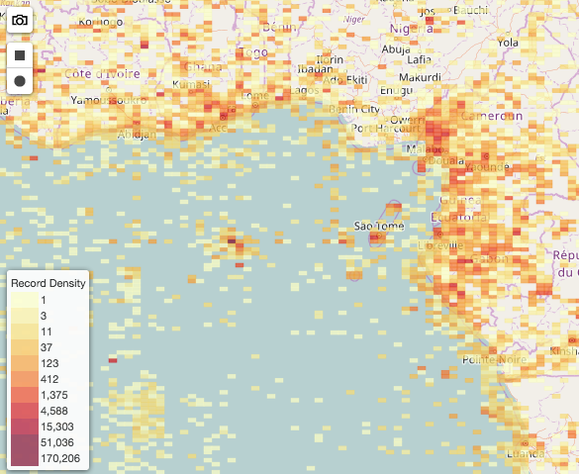
Occurrence data cleaning
Resolves taxon names
Decrease number of columns
Clean localities
Rounds up the latitude/longitude
Removes coordinates at 0.00
Removes coordinates in cultivated zones, botanical gardens, etc.
Removes coordinates outside of our desired range
Removes duplicates
Spatial correction
Produces a csv

Slide 8
Occurrence data cleaning
Resolves taxon names
Decrease number of columns
Clean localities
Rounds up the latitude/longitude
Removes coordinates at 0.00
Removes coordinates in cultivated zones, botanical gardens, etc.
Removes coordinates outside of our desired range
Removes duplicates
Spatial correction
Produces a csv

Slide 9
Manual
Excel or google sheet option
See steps in “Manual/Data_Cleaning/”

Slide 10
Occurrence data cleaning
02_ Occurrence_Data_Cleaning.R
0. Exploring the dataset
Resolve taxon names
Decrease number of columns
Clean localities
Precision
Remove impossible points
Most common coordinate: 0.00, 0.00
Cultivated zones, botanical gardens, etc
Remove duplicates
Spatial correction
Visualize
Save cleaned.csv
Save maxent.csv

Slide 11
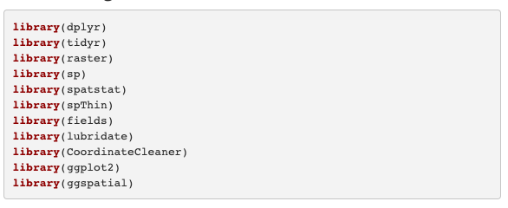
Load Packages
dplyr and tidyr are part of tidyverse
Geospatial packages include raster , sp, spatstat, spThin, and fields
lubridate fixes the dates
CoordinateCleaner is specific to occurrence record processing
ggplot2 and ggspatial are for visualization

Slide 12

Load Functions
This is a function I created with Natalie Patten.
Coming Soon: R package gatoRs (Geographic And Taxonomic Occurrence R-based Scrubbing).

Slide 13
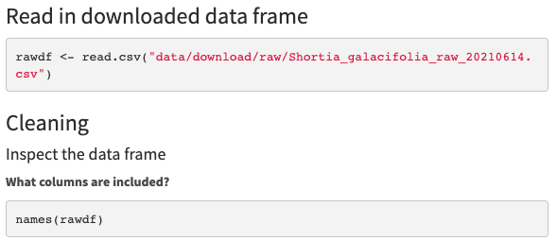
Load Data Files
read.csv is a base function of R, it reads csv files
names print the names of columns

Slide 14
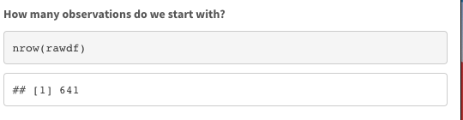
Look at the datafile
nrow prints the number of observations.

Slide 15
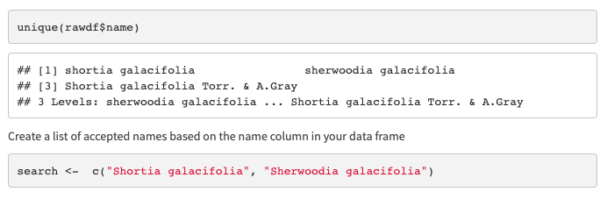
1. Resolve taxon names
unique prints unique values in the column name from the dataframe rawdf.
c creates a list stored in the object search that contains “Shortia galacifolia” and “Sherwoodia galacifolia”

Slide 16
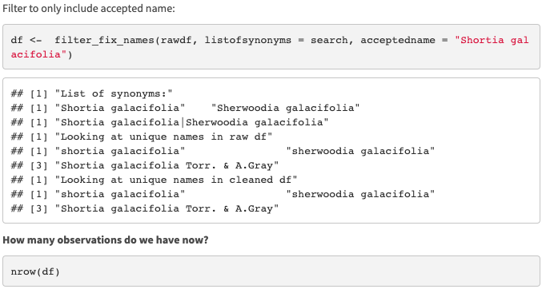
1. Resolve taxon names
prints the number of observations.
filter_fix_name takes a dataframe, a list of synonyms, and the accepted name and returns a dataframe with only the records associated with the species and new_name = accepted_name

Slide 17
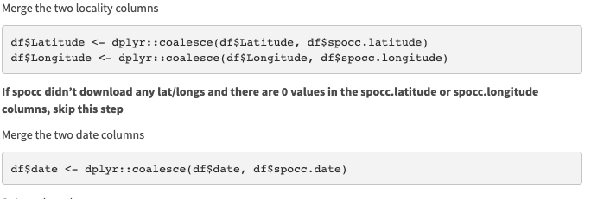
2. Decrease number of columns
coalesce merges two columns into one

Slide 18
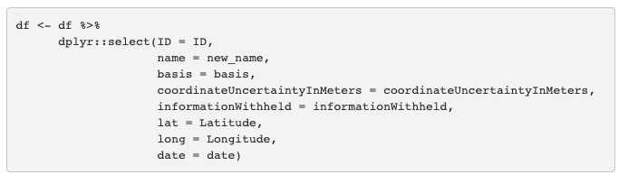
2. Decrease number of columns
select only retains the selected columns. New name = old name.

Slide 19
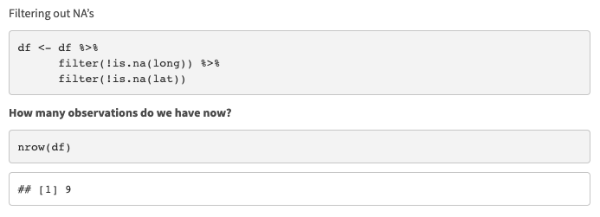
3. Clean localities
filter only retains records in the column long/lat that are not (!) equal to NA (!(is.na()).

Slide 20
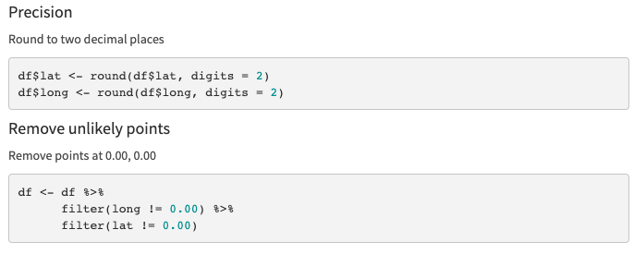
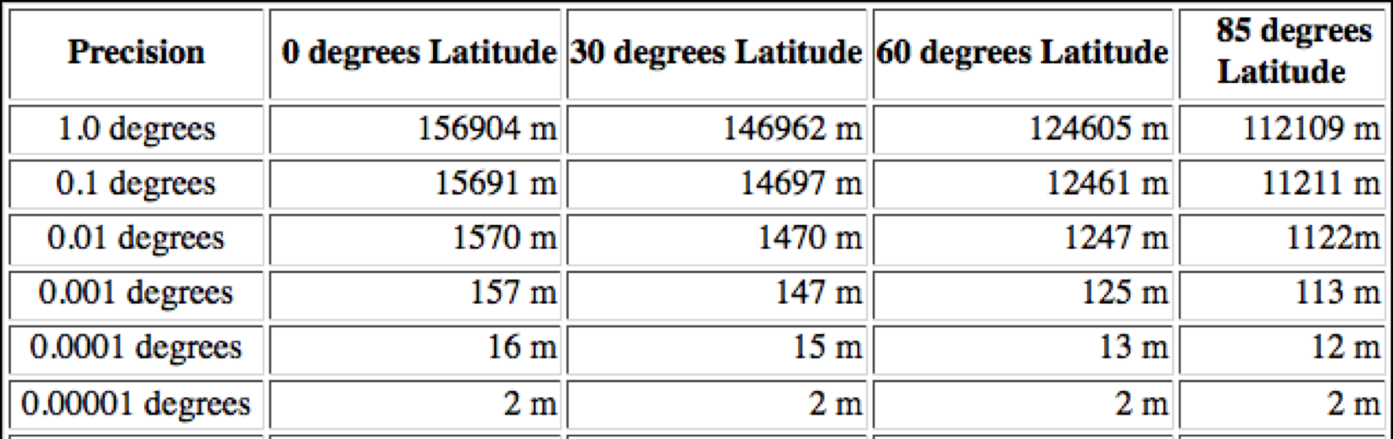
3. Clean localities
round rounds numeric values to two decimal places
Our climate layers are 30 arc-sec resolution which is about 1000 meters

Slide 21
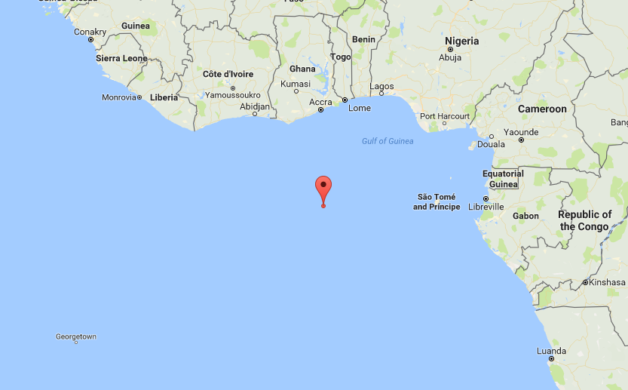
3. Clean localities
filter only retains records in the column long/lat that are not (!=) equal to 0.00
”There’s no place like 0,0”

Slide 22
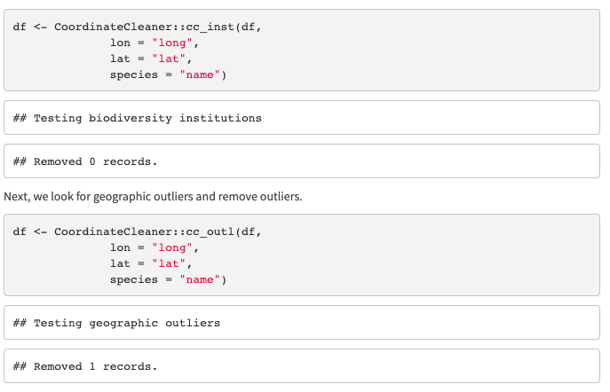
3. Clean localities
Removes points in a radius
around biodiversity institutions
Removes geographically isolated records of a species using quantile method
Zizka et al. 2019. CoordinateCleaner: Standardized cleaning of occurrence records from biological collection databases. Methods in Ecology and Evolution.

Slide 23
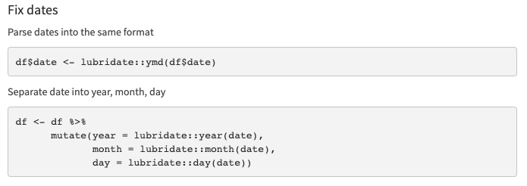
4. Remove Duplicates
lubridate is a beautiful package that parses dates
mutate (from the package dplyr) allows us to make 3 new columns to store year, month, and day

Slide 24
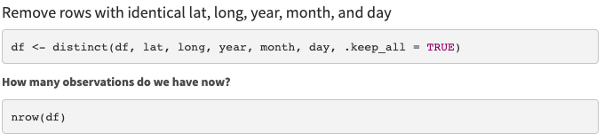
4. Remove Duplicates
distinct identifies duplicates based on specific columns

Slide 25
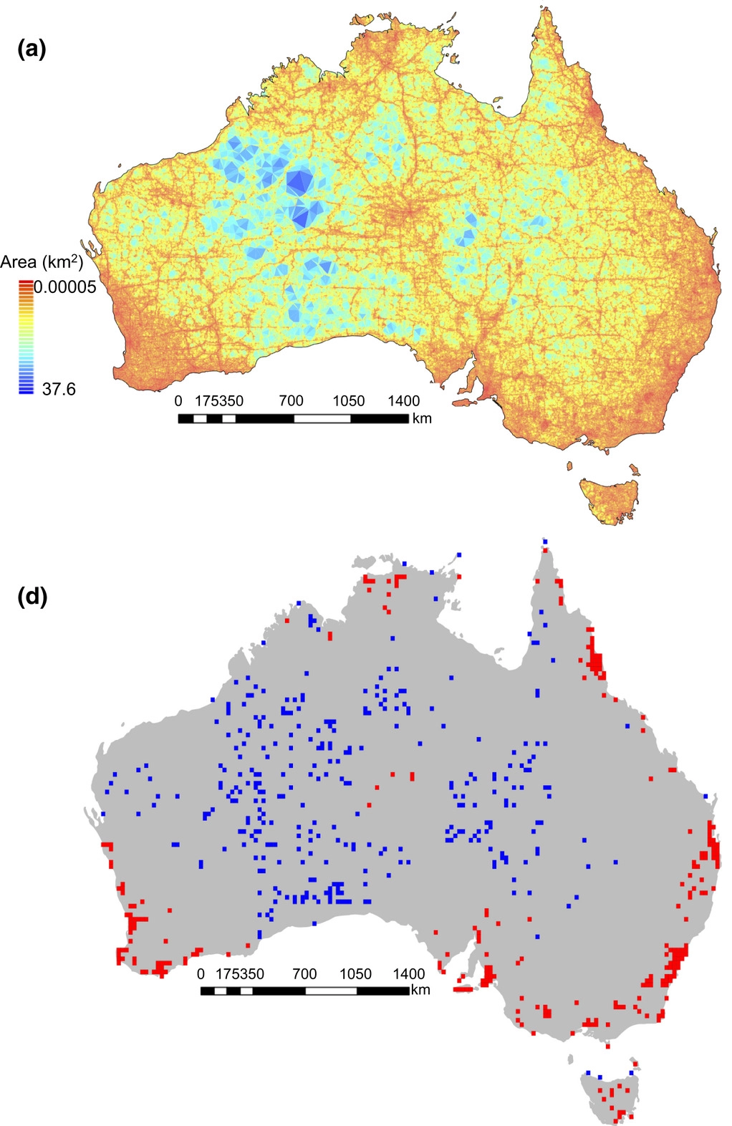
Sampling bias for
857,245 records
5. Spatial Correction
Filtering is a procedure to reduce the clustering of species records
Collection efforts can lead to clustering of points
Daru et al. 2017. Widespread sampling biases in herbaria revealed from large-scale digitization. New Phytologist.
Notes:
Filtering is a procedure to reduce the clustering of species records .
Figure shows hotspots related to

Slide 26
5. Spatial Correction
Filtering is a procedure to reduce the clustering of species records
Collection efforts can lead to clustering of points
After filtering, there may still be spatial autocorrelation
This can be accounted for by data partitioning
Distance
Env. Similarity
Sillero N. and A. M. Barbosa. 2020. Common mistakes in ecological niche models. International Journal of Geographical Information Science.
Notes:
Filtering is a procedure to reduce the clustering of species records

Slide 27
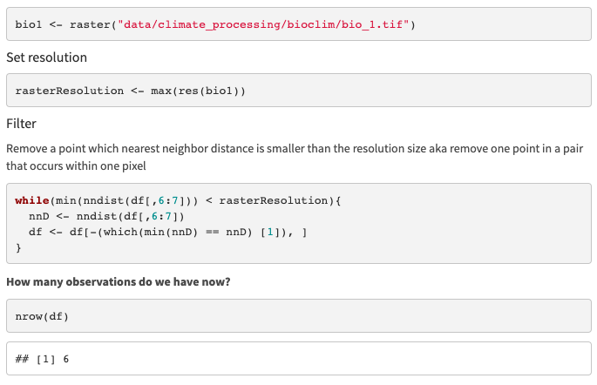
5. Spatial Correction
Notes:
Filtering is a procedure to reduce the clustering of species records

Slide 28
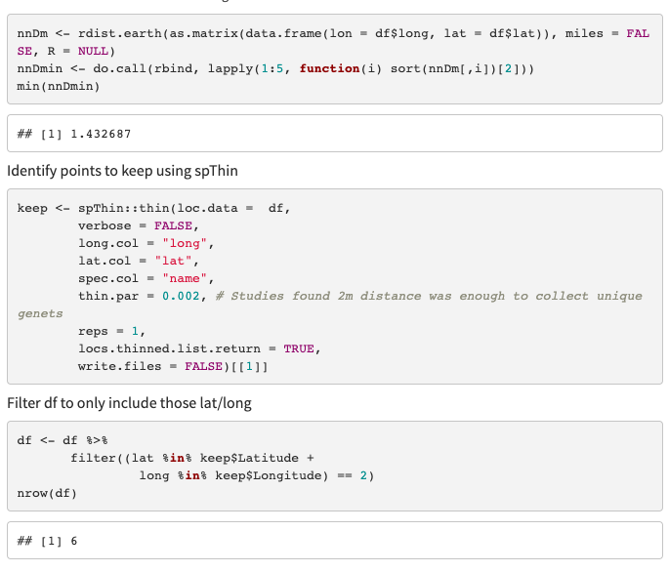
5. Spatial Correction
rdist.earth can be used to look at nearest neighbor distance in kilometers
do.call applies to a list, rbind binds rows, and the sort is set up to select the lowest value.
We want to look at the min distance between points remaining
In the next step, if your thin.par is less than this amount, no points will be removed

Slide 29
5. Spatial Correction
spThin function thin
Set thin.par = minimum nearest neighbor distance
Next, the function calculates pairwise distance between all records
Then:
1) For each record, IDs the # of occurrence records within distance thin.par
2) One record of those which share the greatest # from (1) is removed at random.
3) Repeat 1 – 2 till no record has a nearest neighbor closer than thin.par
Aiello-Lammens et al. 2015. spThin: an R package for spatial thinning of species occurrence records for use in ecological niche models. Ecography.

Slide 30
5. Spatial Correction
Don’t print running details!
Returns list of data frames, we only want Part 1 of the list!

Slide 31
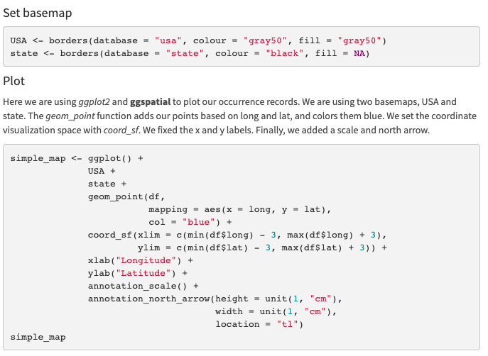
6. Plot Cleaned Records
Using the function borders from the package ggplot2, we download basemaps to plot our points on.

Slide 32
6. Plot Cleaned Records
1. Add basemaps
2. Add points
3. Zoom in
4. Fix axis labels
5. Add scale and North arrow

Slide 33
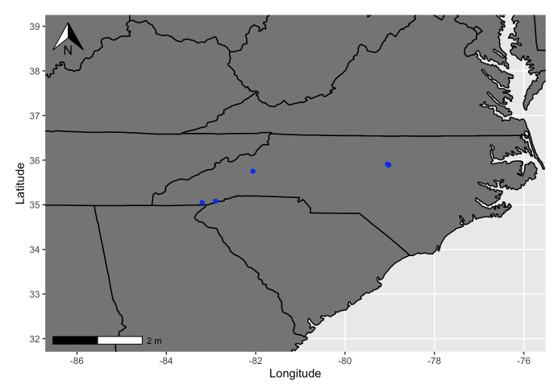
6. Plot Cleaned Records

Slide 34

7. Saved Cleaned.csv

Slide 35
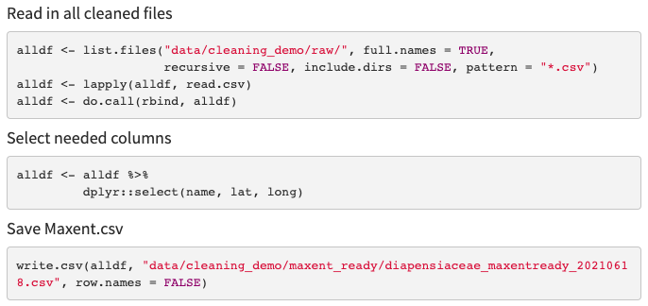
7. Make MaxEnt Ready
1. Create list of files with paths
2. List apply and read.csv
3. Bind all dataframes by their rows

Slide 36
Minimum occurrence records
Your points should represent the env. variability true to your species.
Too few points may not classify your species suitable conditions properly.
It is not clear the minimum number of points needed.
Might be dependent on the extent of the study area
3, 4, or 5 have been suggested
5 per env. variable has also been suggested
More env. variables may not significantly change the minimum sample size needed (see study below).
Proosdij et al. 2016. Minimum required number of specimen records to develop accurate species distribution models. Ecography.

